Slide 1

CS-170 Final Project
Submitted by: Rach Wascoe
Supervised by: Atia Sultana

Slide 2
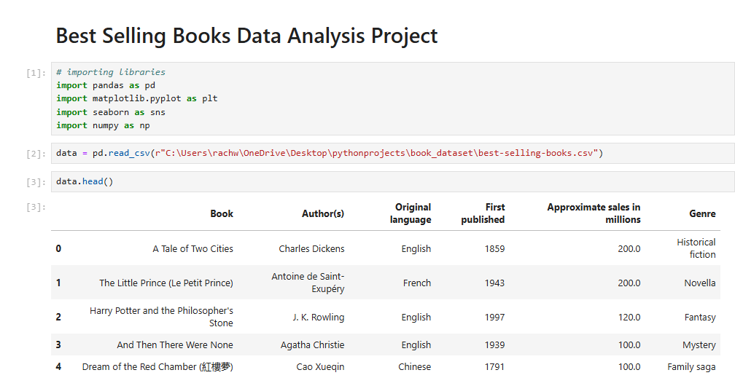
Importing Libraries and Getting Started

Slide 3
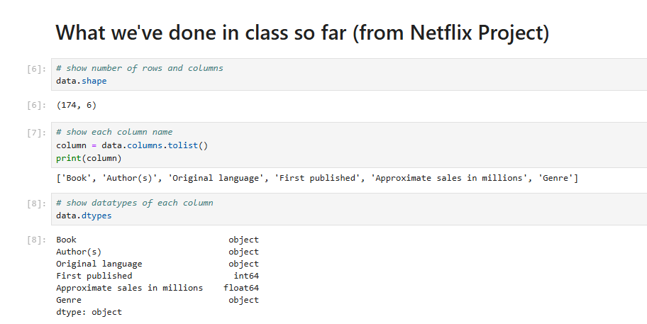
Finding Shape/ Datatypes of Dataset

Slide 4
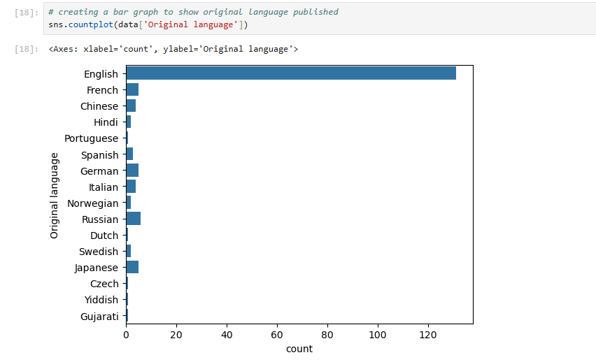
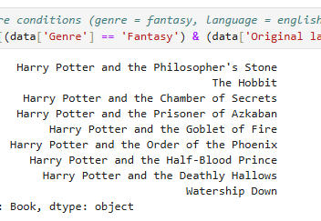
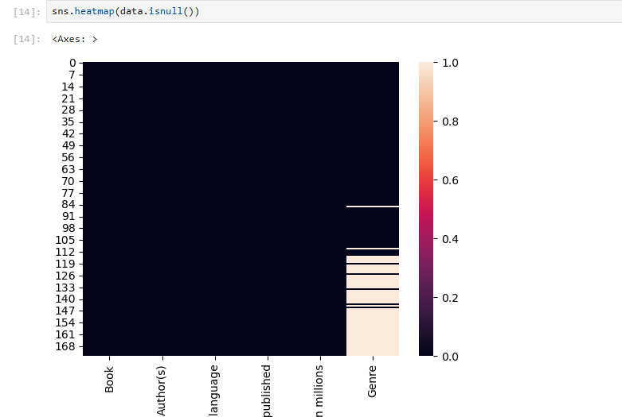
Working with Language and Genre

Slide 5
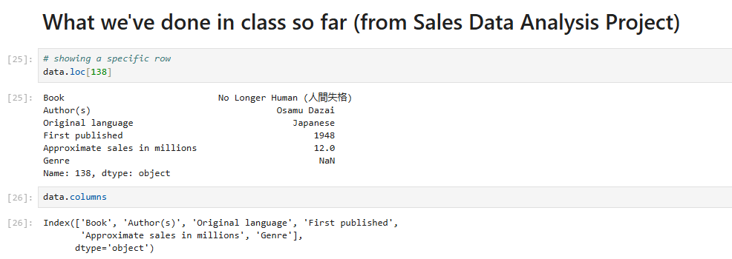
Finding a Specific Line Using Loc

Slide 6
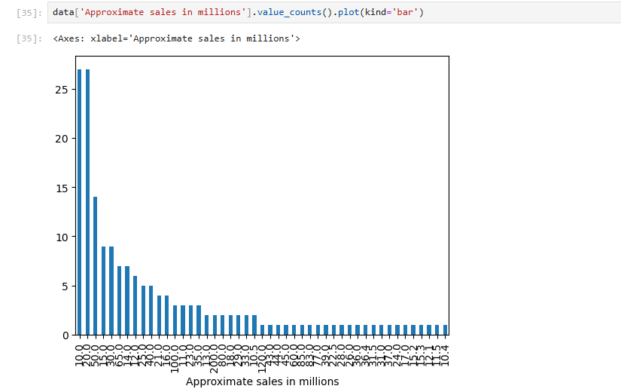
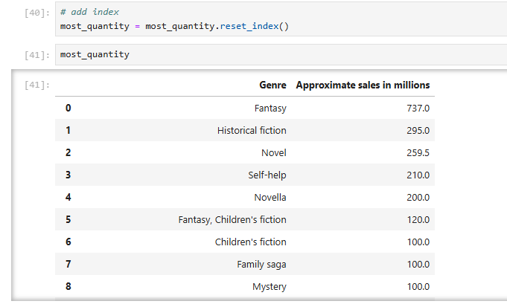
Looking at Sales and Genre

Slide 7
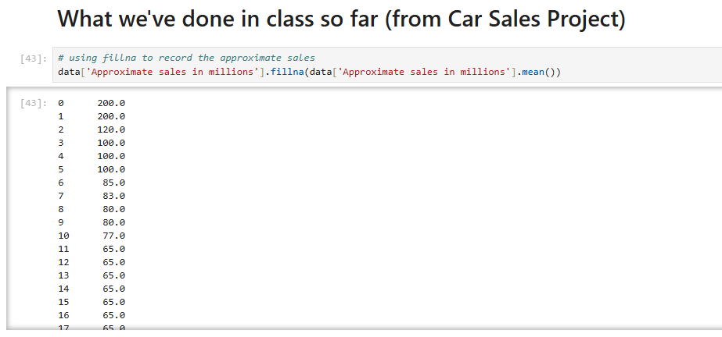
Finding Sales for each Book Using fillna

Slide 8
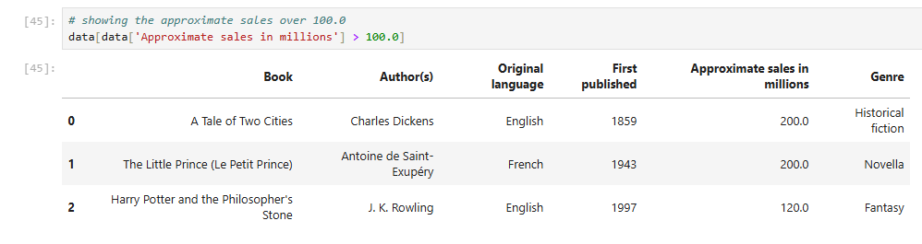
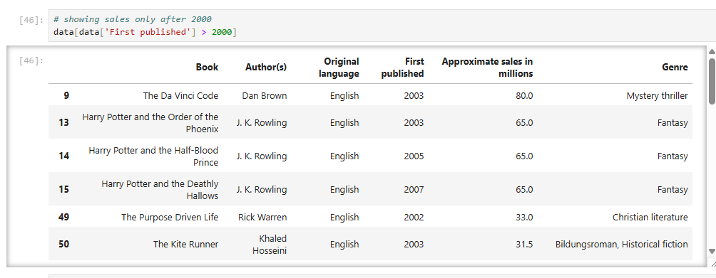
Looking at Sales over 200.0 (mil) and Published after 2000

Slide 9
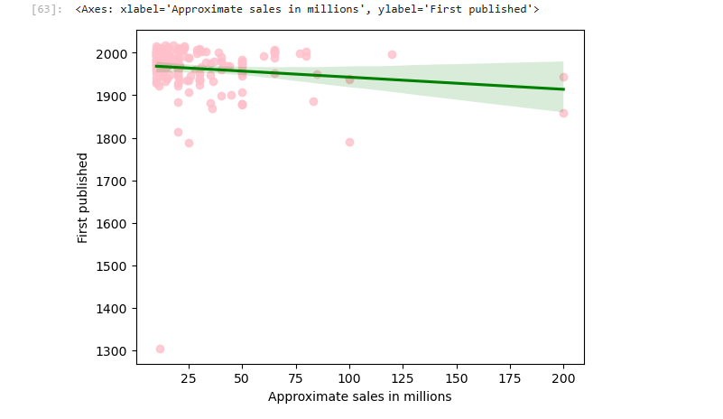
Scatter plot showing Sales and First Published

Slide 10
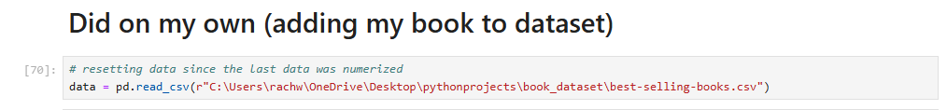
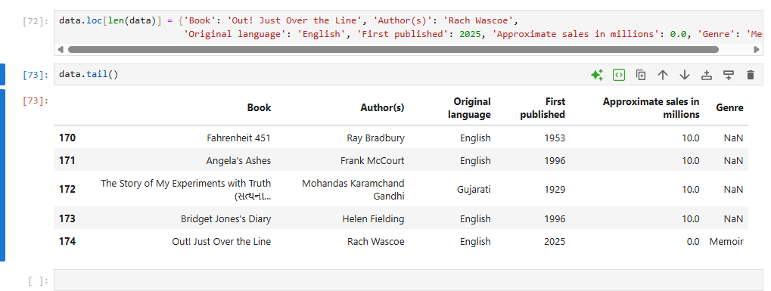
Adding my own book to Dataset

Slide 11
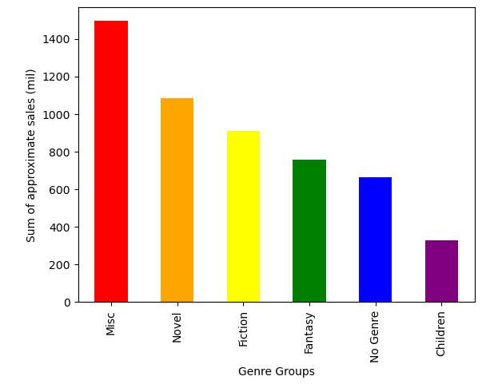
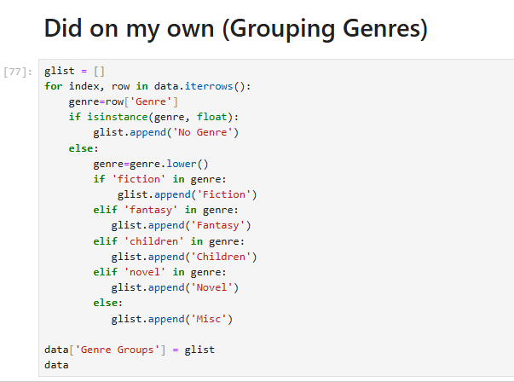
Grouping Genres

Slide 12

Conclusion
Grouping genres was difficult at first but I was able to use what we did earlier in class (like for loops with if/else statements) to figure it out
Overall, the project gave me information about the correlation between genre and sales (this is helpful as a writer to know what genres are increasing in sales)
This class helped me to understand how basic coding works and how to understand datasets through code
Do you have any questions?

